Slide 1
Data Science with Generative AI
Discuss impacts and limitations of Generative AI
Discuss ML Operations inside businesses
Discuss FAIR AI and ethics, explainability
Discuss the advent of synthetic data generation and differential privacy, and its implications
Design prototypes for generative AI

Slide 2
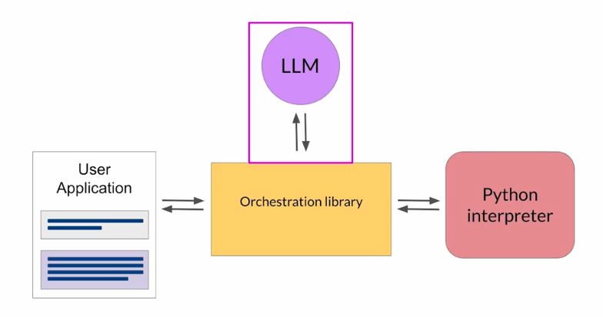
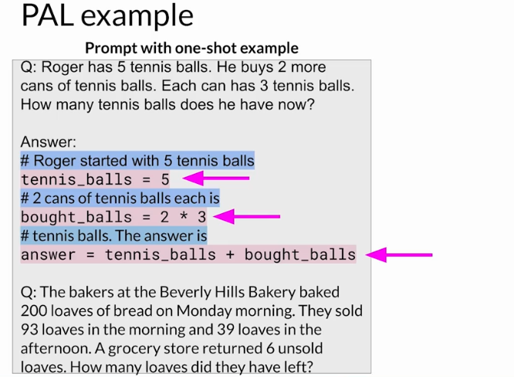
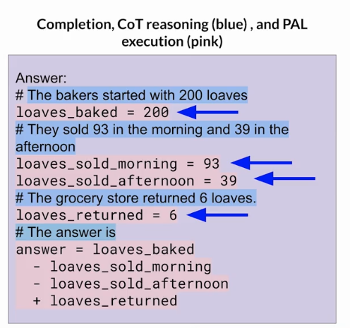
Data science with generative AI

Slide 3
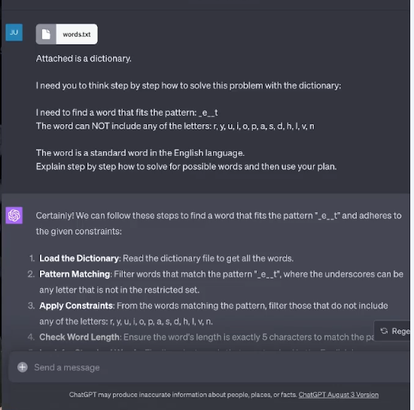
Python code
Code interpreter

Slide 4
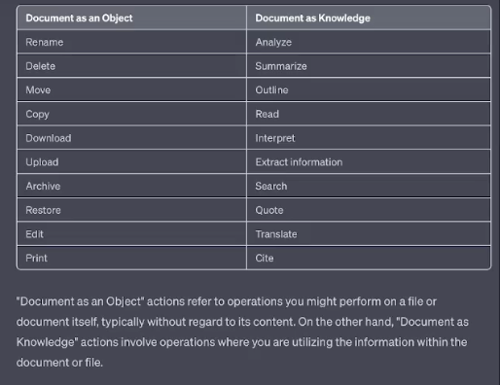
Creating files, process files, transformations, extraction of information

Slide 5
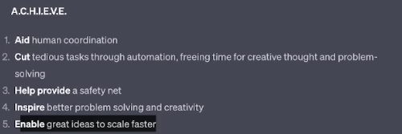
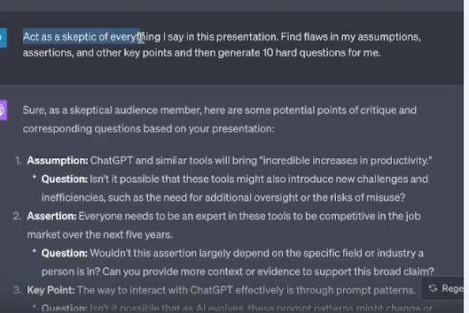

Slide 6
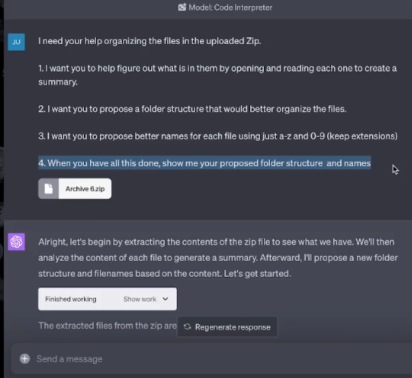
LLM is your intern and assistant
IT know how to program
but people don’t trust them. You know its capabilities but it can make mistake.
Memory is not that good.
Give feedback
Automation
When working with Code Interpreter, think of it as your intern or assistant.
You will need to:
1. Break things down step by step
2. Provide all the necessary context or information to accomplish a task
3. Provide detailed feedback on what to improve
4. Do not expect the work to be perfect or error-free
5. Always review everything for accuracy
6. Don't expect Code Interpreter to be a mind reader, you need to be very specific about your goals, constraints, needs, etc.

Slide 7
Ask questions about documents
Getting information into the conversation!
If you see it is better! List all columns, explain the columns or mapping
Hallucinations and training
Small documents
Big documents, ex. Policies – using maps

Slide 8
Working with larger documents
Break the document down into individual pieces – extract each page of the pdf in a separate file.
Open each page manually and summarize what is on each page/slide
Outputs are also limited so, you will need to proceed.
Building an index or mapping

Slide 9
Data cleansing, Creating data visualization
It is super good for structured data
Transform first, to make prompts easy
It is a tool to help you not to substitute you
Unstructured data
Help LLM to structure the data

Slide 10
Automation – conversations turn into software utilities
Zip the files that you want to automate
Turn this process into a Python program that I can download and run on my computer and provide the paths to the documents as a command-line arguments. Zip up the program for me download.

Slide 11
Heuristic to avoid errors
Big flow to smallest flow
Test cases!

Slide 12
Advanced data analytics
1. Saving Intermediate Files
Why: To prevent loss of progress, allow assembly of multiple outputs, and enable various directions based on intermediate files.
How: Regularly save files at different stages of the project, allowing for flexibility in assembling outputs or taking the idea in multiple directions. These act as safety nets, ensuring that no work is lost. If ChatGPT Advanced Data Analysis times out, provide it the files that you previously downloaded. You can also ask for a Zip file with all the files generated thus far. You can also take an intermediate output and iterate on it in multiple independent conversations by uploading it to each one.
2. Always Plan Step-by-Step
Why: For a seamless process that enhances repeatability.
How: Collaborate with ChatGPT Advanced Data Analysis to outline specific, detailed, and actionable steps. Save these plans for future reference or to restart a process, making the process more reliable. You can use human or AI planning, but having a step by step plan is key. Save plans as a file so that they are easier to repeat by uploading them at the start of a new conversation.
3. Use Mementos
Why: To have reminders of the state of the ongoing process.
How: Have ChatGPT Advanced Data Analysis create files listing the entire plan, the current step, and summarizing what has or hasn't been done. These mementos are different from the plan itself and act as a guide to the current state of the process. You can upload these to restart a process from a given point or help Code Interpreter remember where it is in the process.
4. Always Have ChatGPT Advanced Data Analysis Read and Explain Documents/Data
Why: To synchronize your understanding with GPT-4's understanding.
How: Request ChatGPT Advanced Data Analysis to explain what it reads in several ways and test its understanding by having it generate examples or explanations that demonstrate the concepts in the document. Make sure that you and Code Interpreter have the same understanding regarding the documents, data, etc. that you provide. Asking it to generate new examples of concepts is a great way to test reasoning.
5. Use Error Detection Methods
Why: To ensure consistency and accuracy.
How: Employ references to specific identifiers or quotations to ensure that the output is supported by the documents you provided. Build custom test cases with real or synthetic data to ensure outputs are consistent with the input documents. If you can't work with real data yet, generate synthetic data to test out a process and accuracy.
6. Ask ChatGPT Advanced Data Analysis to Try Alternate Approaches
Why: To overcome failure and make continuous progress.
How: If an approach fails, prompt ChatGPT Advanced Data Analysis to explore different strategies. Provide hints or ask it to plan, list, describe the rationale behind, and employ alternate methods.
7. Think of Prompts as Constraints
Why: For targeted and desired outputs.
How: Be explicit about your goals, requirements, and constraints. ChatGPT Advanced Data Analysis will try to generate any solution that fits, so the more specific you are, the closer the output will be to your needs. Don't ask for a fruit if you really want a green banana.
8. Edit the Conversation When Errors Occur
Why: To avoid error propagation.
How: Edit and correct any chat message that produces a bad output immediately and regenerate the output. Clean conversation histories are preferred to prevent introducing erroneous information that causes problems later.
9. Get Key Information into the Conversation
Why: To enhance reasoning and understanding.
How: Include all necessary information directly in the conversation so you and ChatGPT Advanced Data Analysis have a common understanding. Visibility of information makes reasoning more effective. If you can see the information in a recent chat message, Code Interpreter can as well.
10. Tell ChatGPT Advanced Data Analysis to Analyze Without Python When Needed
Why: Not all tasks require code.
How: If you are getting poor reasoning on unstructured text, direct ChatGPT Advanced Data Analysis to analyze, read, or summarize "without using Python code" or "manually". In most cases, you don't want Python code doing the textual analysis.

Slide 13
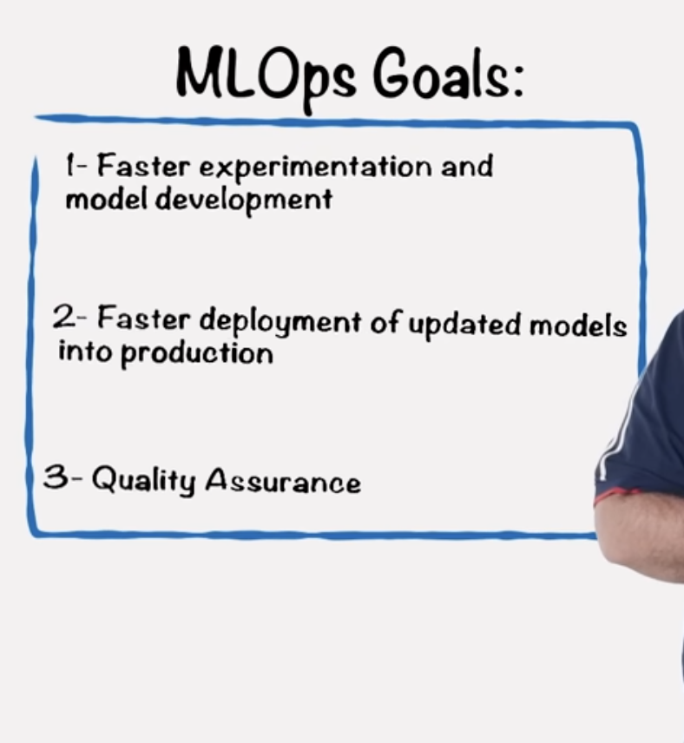









MLOPS
Applications of DEVOPS practices an principals to Machine learning workflow

Slide 14
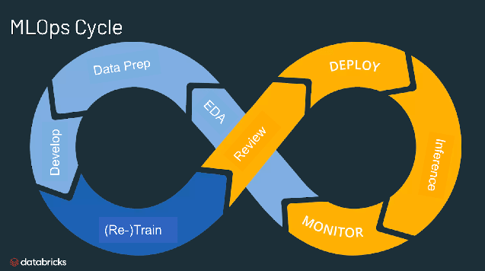










Slide 15
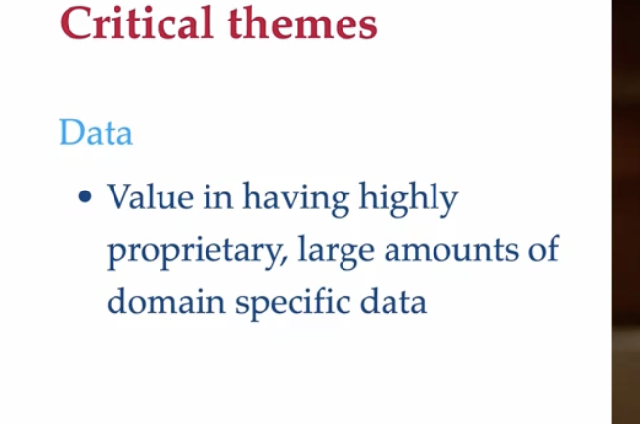
Impacts and challenges of Generative AI Competitive advantage

Slide 16
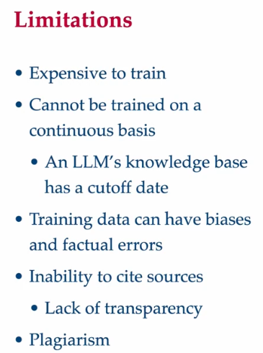
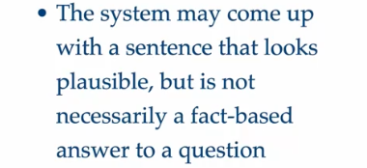

Slide 17
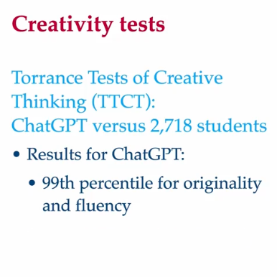
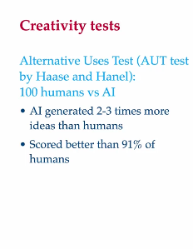
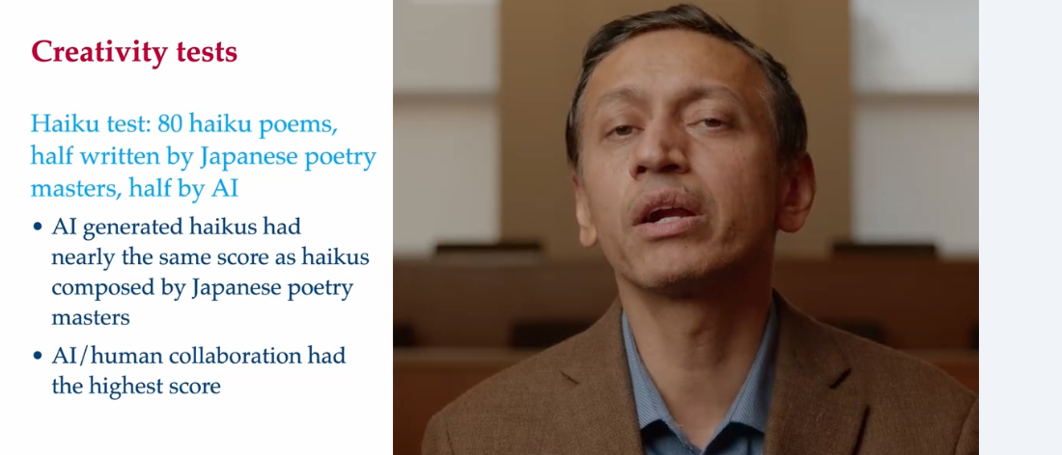





Slide 18
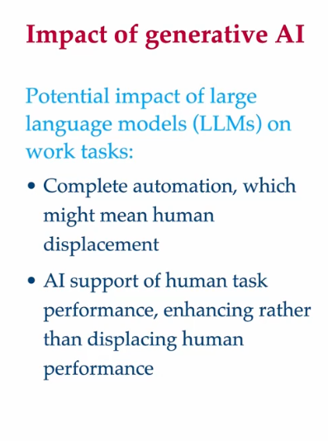

Slide 19
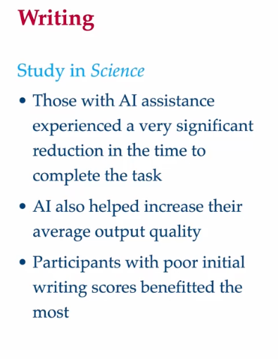
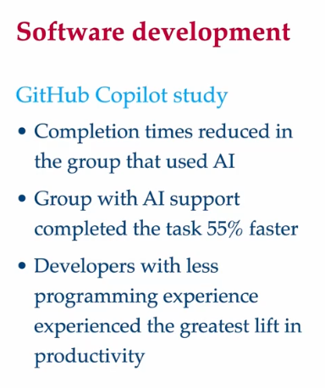

Slide 20
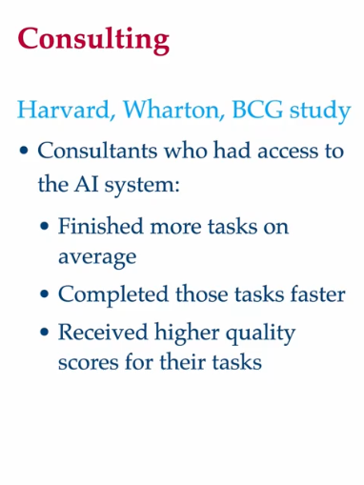

Slide 21













Fairness and ethics Responsible AI

Slide 22
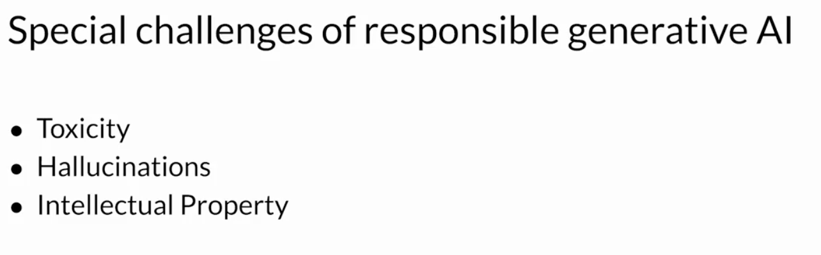
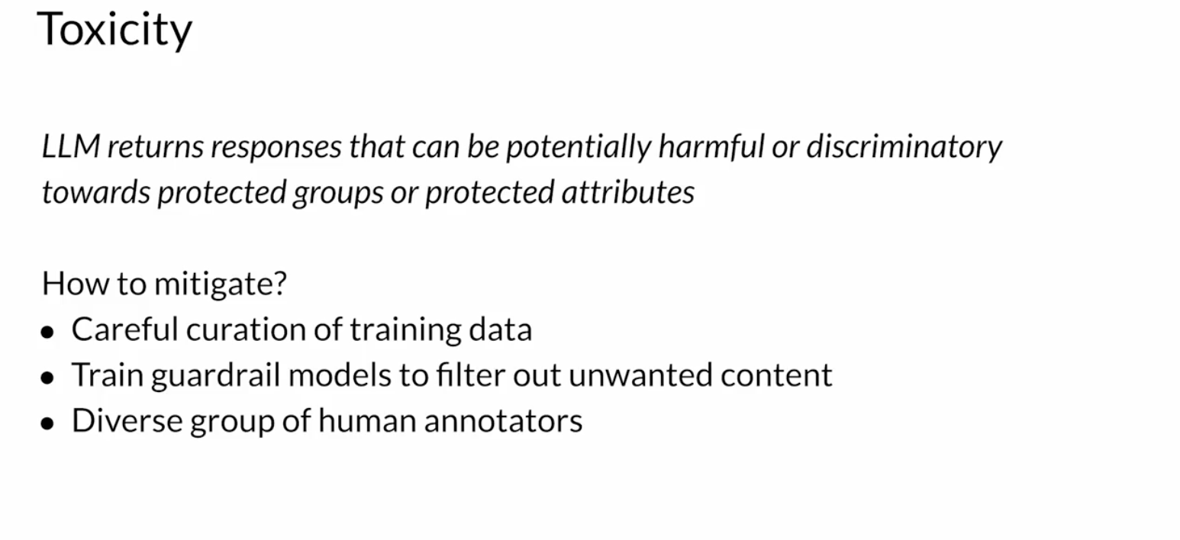
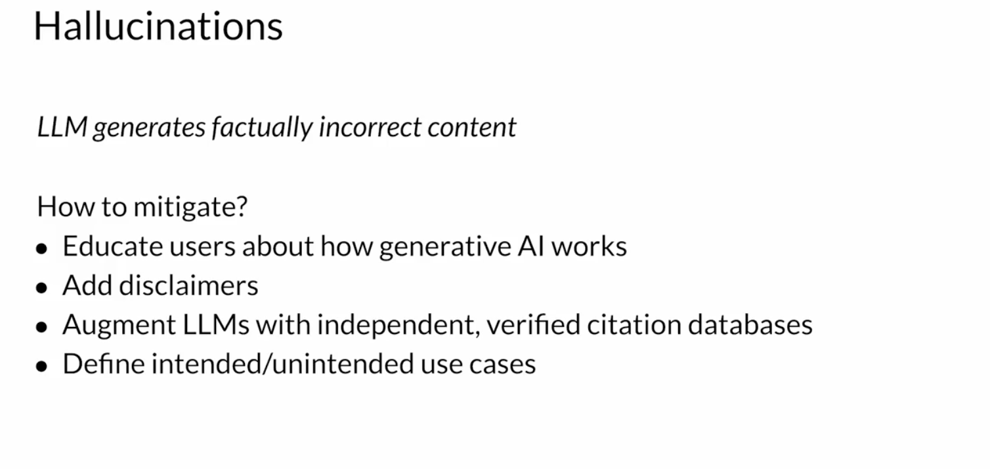
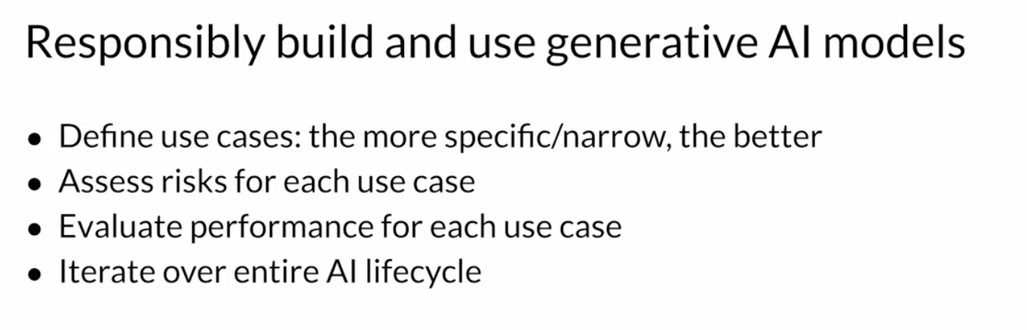
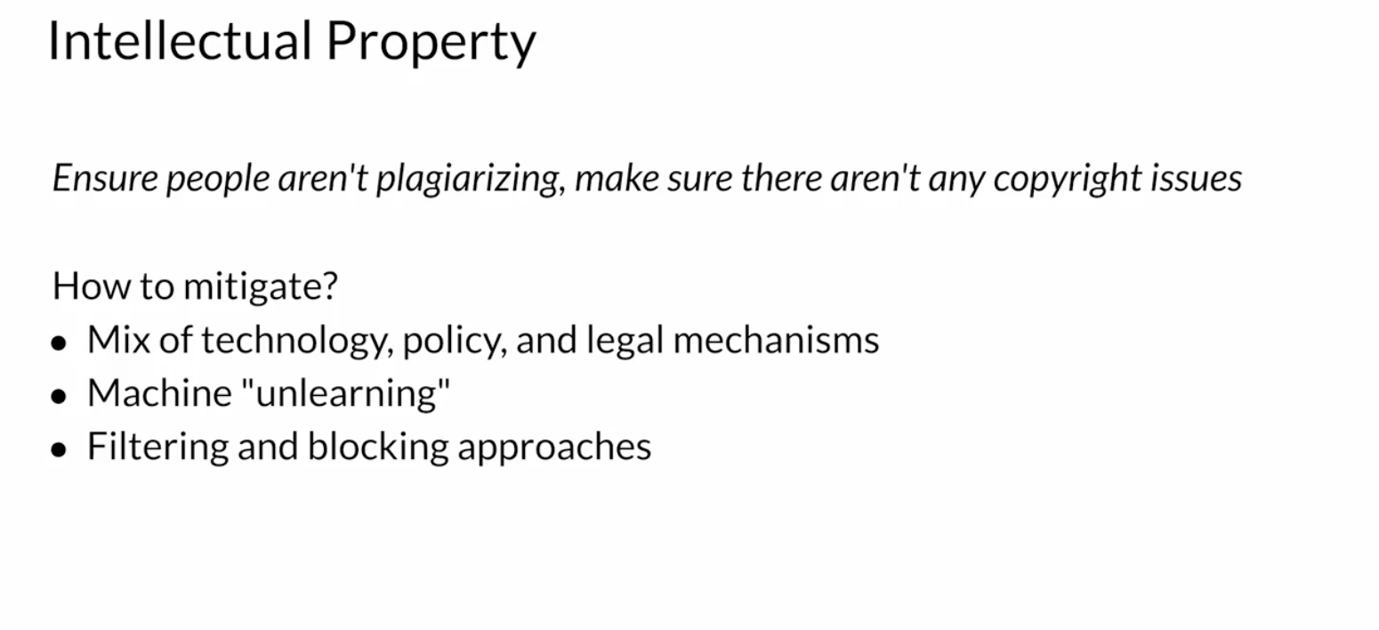







Fairness and ethics Responsible AI
Governance Policies and accountability for every stakeholder

Slide 23
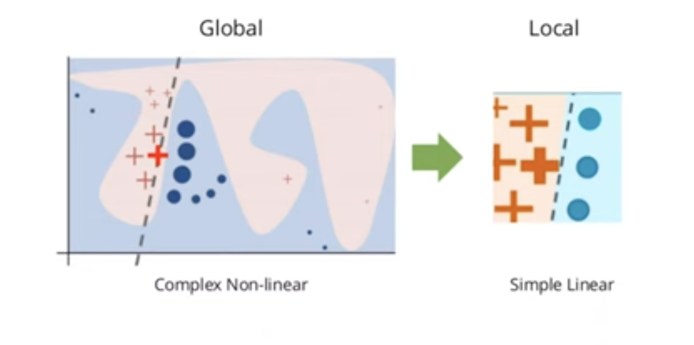
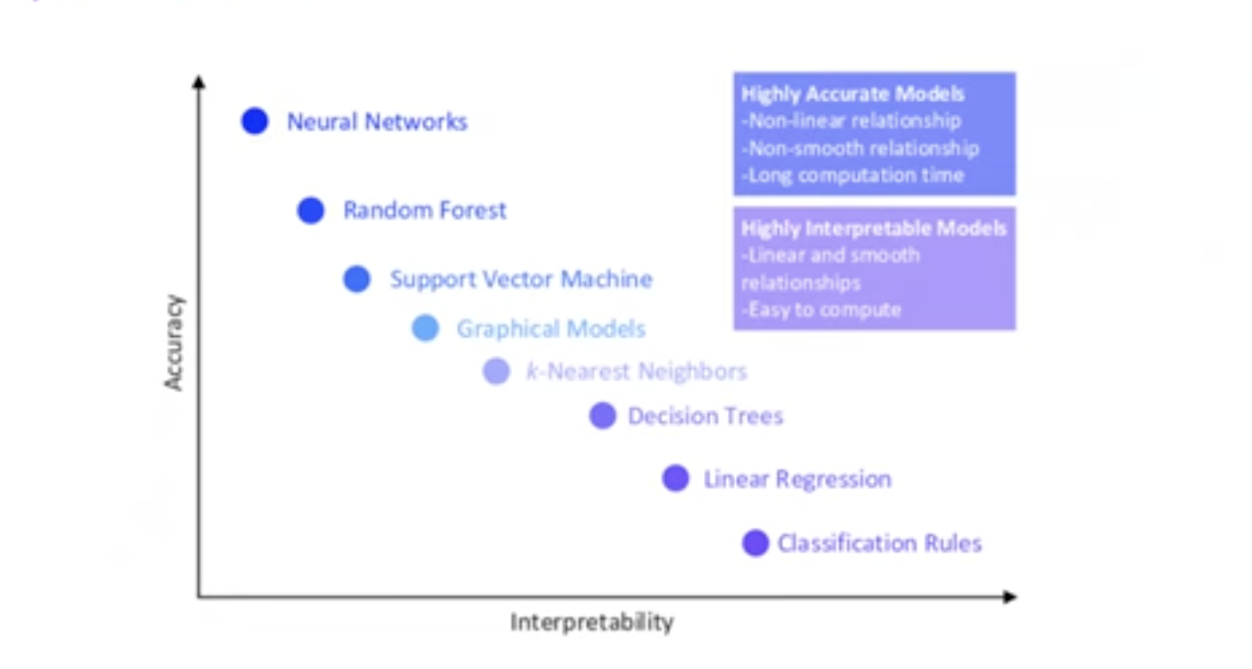
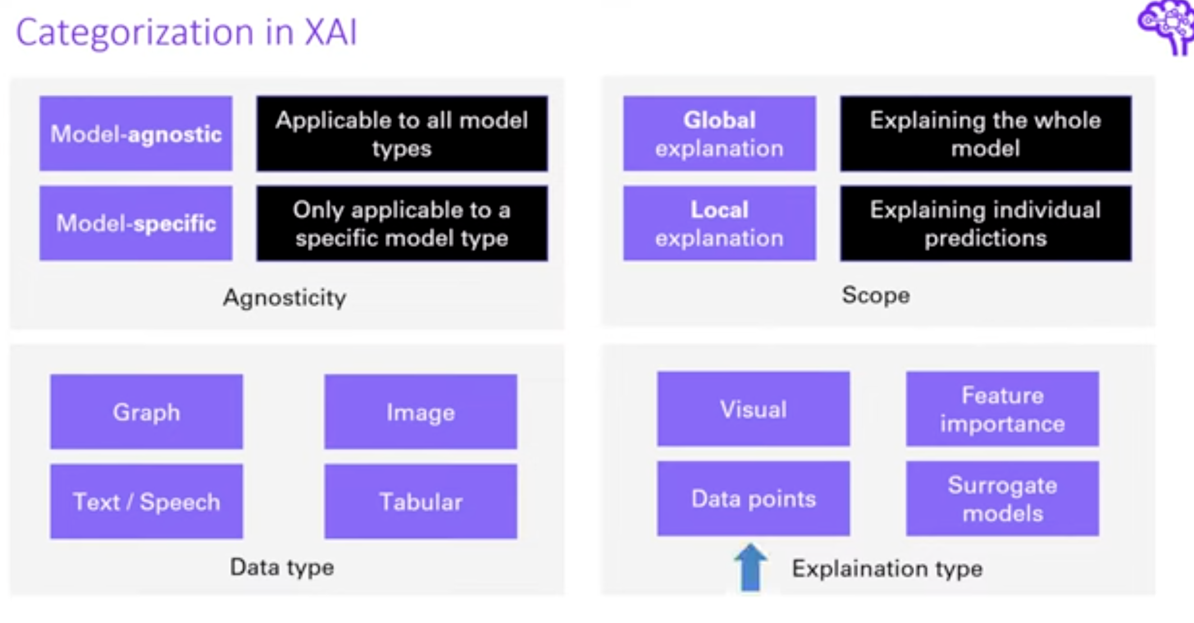
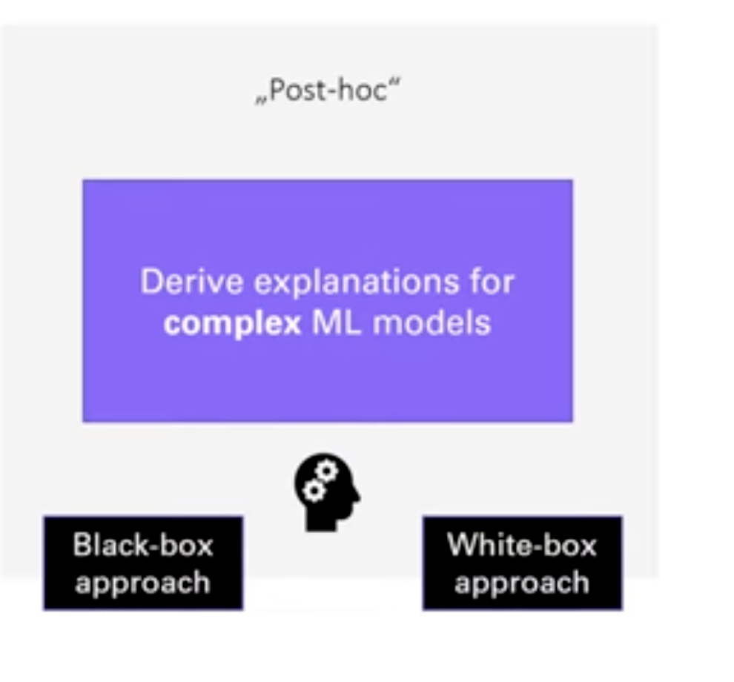
Explainable AI tools

Slide 24
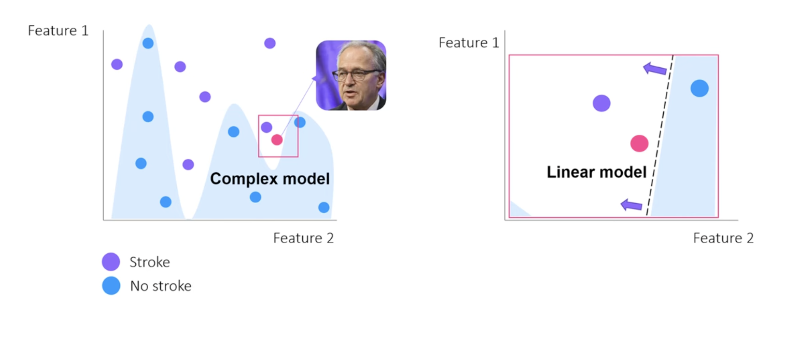
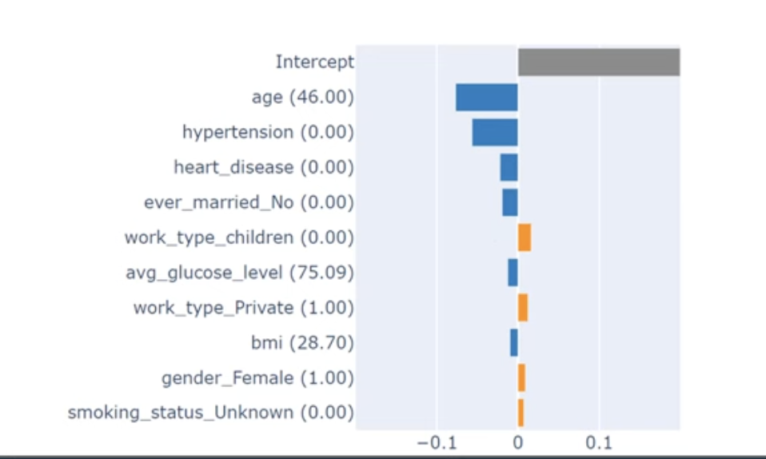
Explainable AI tools
Lime

Slide 25
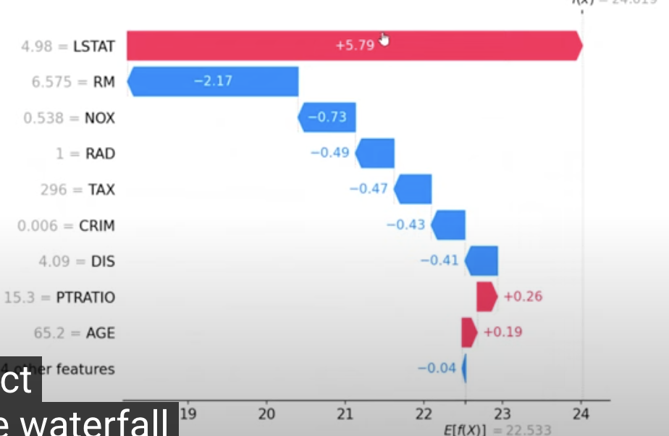
Explainable AI tools
Shap values
Based on game theory
Shows the contribution of
the future for the result locally
But it can be aggregated to come to global explanations.

Slide 26
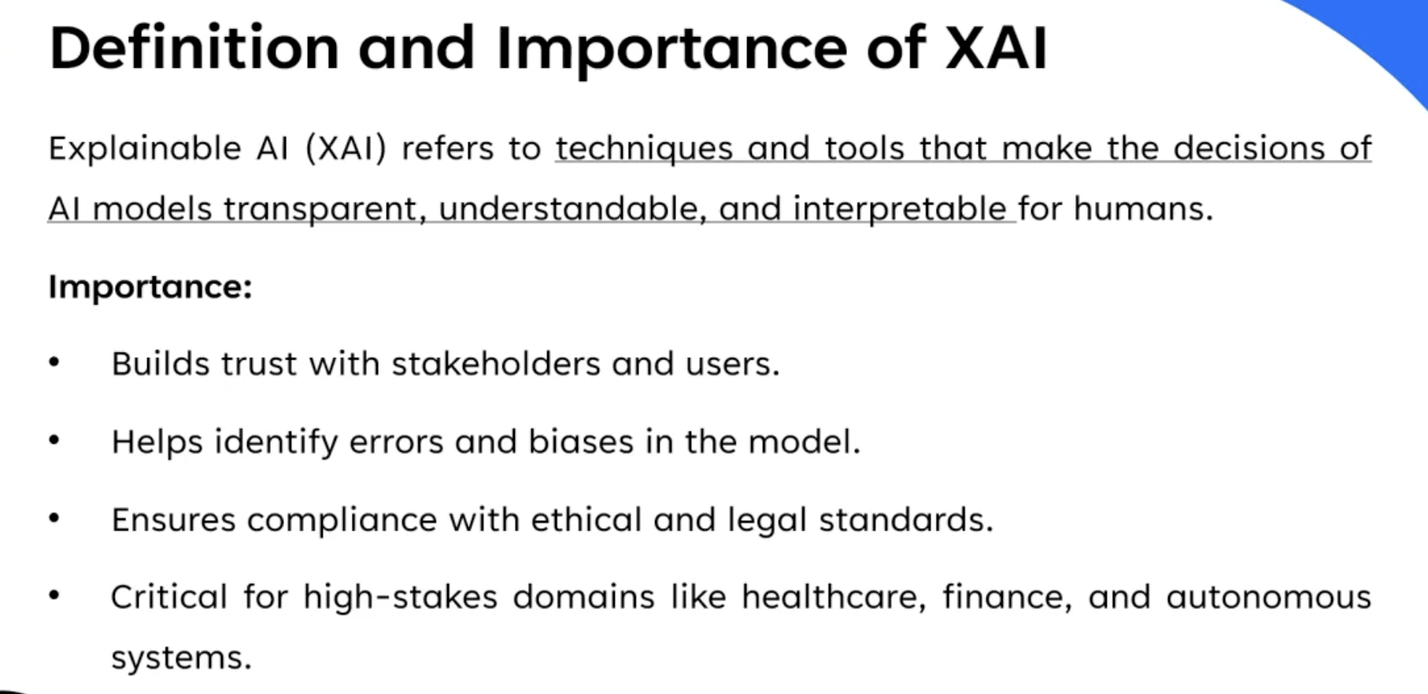

Slide 27
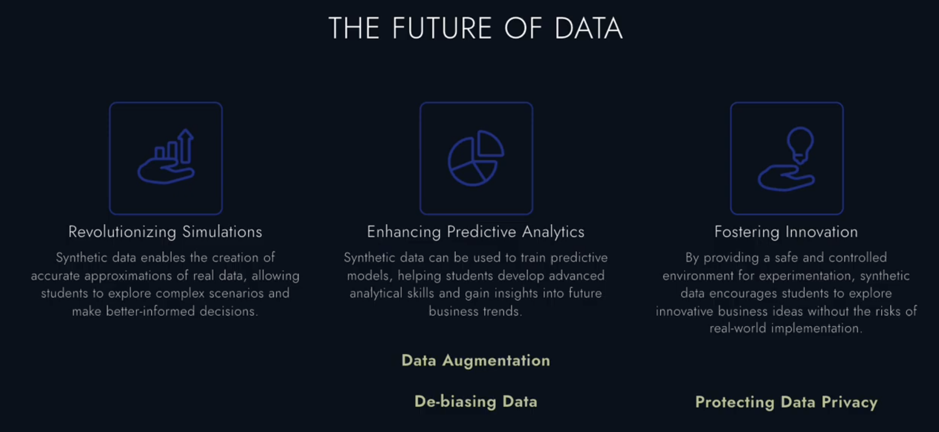
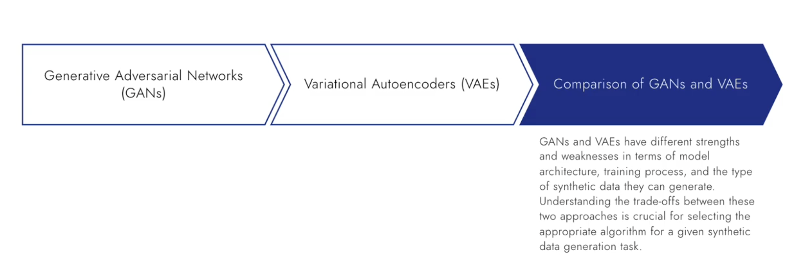
Synthetic Data and Differential privacy

Slide 28
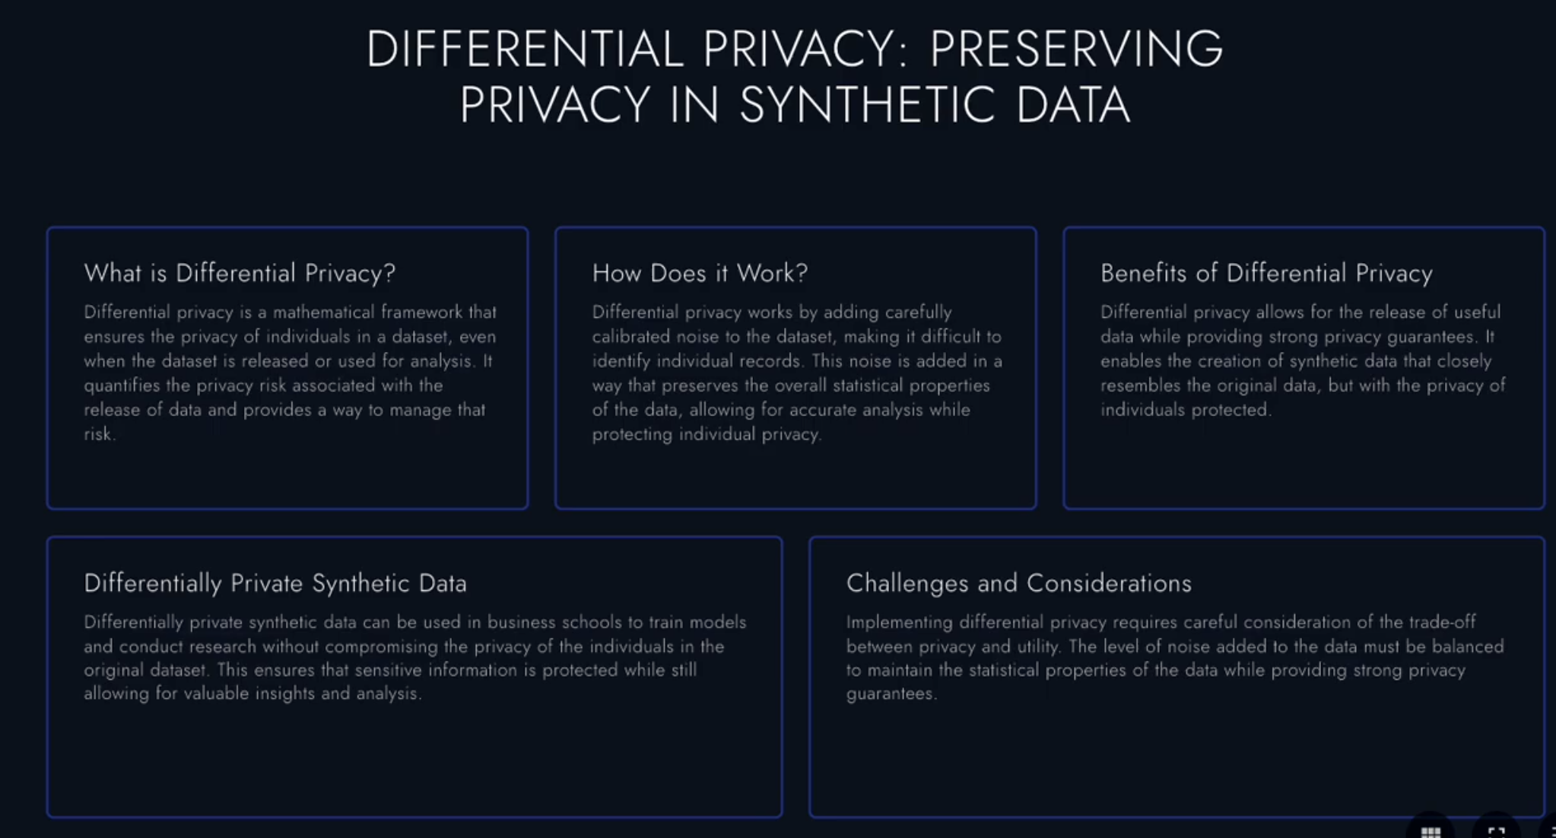
Synthetic Data and Differential privacy

